Slide 1
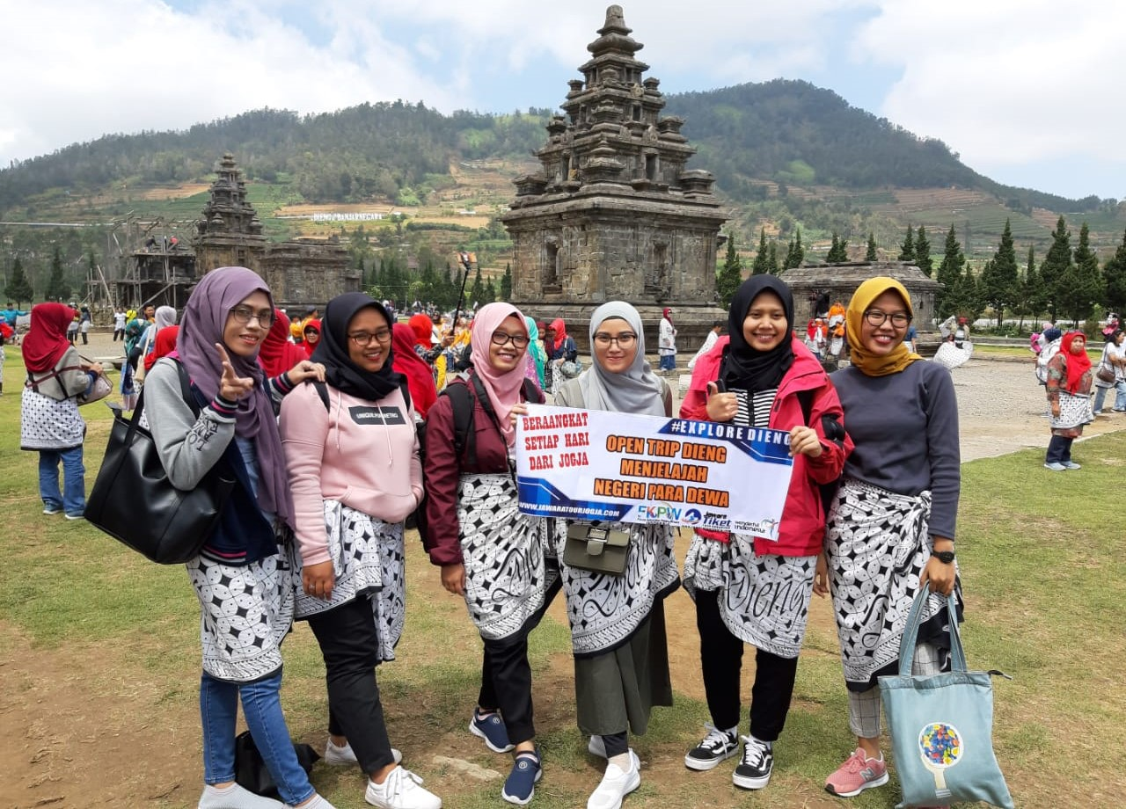
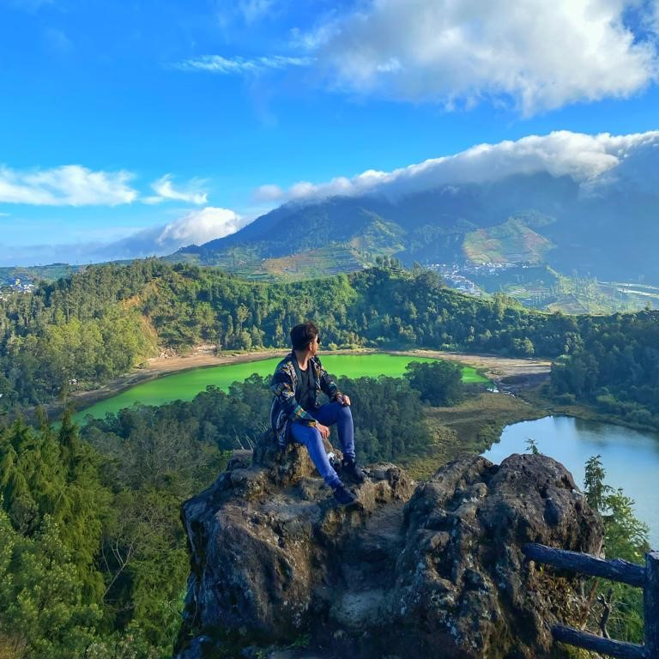
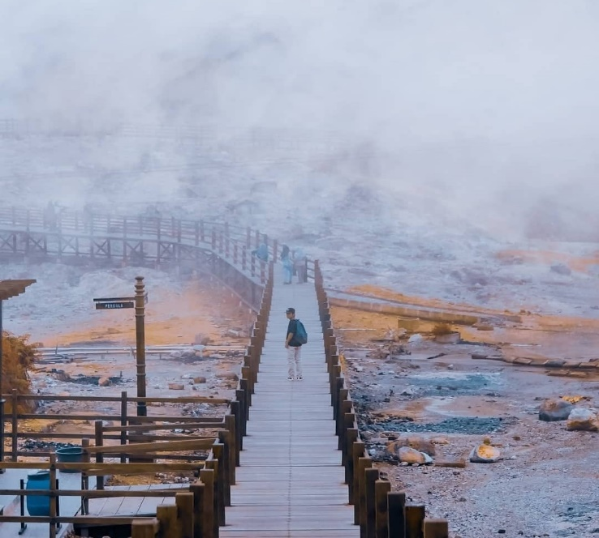
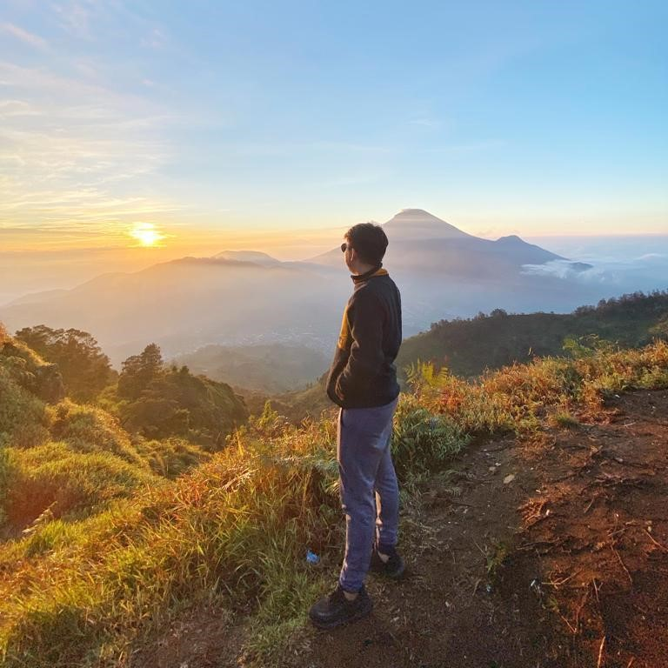
385rb
Per Pax
Open Trip Dieng
Sunrise Sikunir & Explore Dieng
Metting point : Jogja - Magelang
Jawara Tour Organizer | www.jawaratourjogja.com | IG : @jawaratourjogja | WA 085643322718

